Slide 1

PRELIMINARY PROPULSION SIZING 2
AESP 415 – Aircraft Design Part I Basics
Lecture 10
MODULE
3
TOPIC 7
Dr. Wout De Backer
1000 Catawba St, Ste 120
wdbacker@cec.sc.edu

Slide 2
Are you on track for this course?
Have you completed the class 1 weight estimation?
Have you calculated/verified the OEW, Mission Fuel Weight and MTOW?
Have you started the T/W – W/S diagram (Stall/Take-off)?

Slide 3
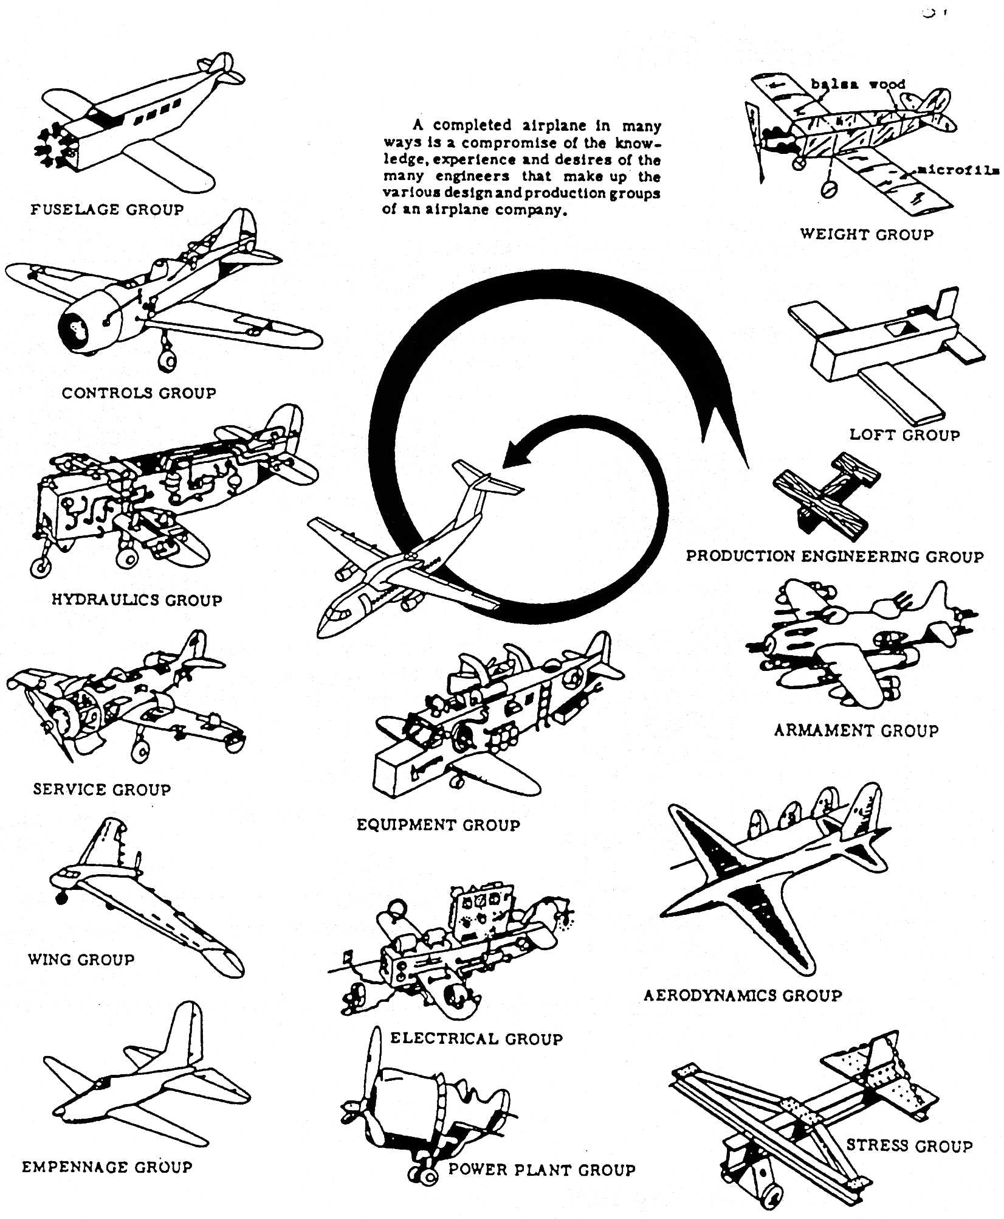
Lecture Contents
Preliminary Propulsion Sizing
7.1. Introduction
7.2. Gas Generators
7.3. Gas Turbine Thermodynamics (Recap)
7.3.1 Ideal Cycle
7.3.2 Gas Power & Efficiency
7.3.3 Real Processes
7.4. Gas Turbine Classifications & Configurations
7.5. Governing Equations of Gas Turbines
7.6. Engine Scaling techniques
7.6.1 Piston Engine Scaling
7.6.2 Propeller Engine Scaling
7.6.3 Turbojet Engine Scaling
7.6.4 Effects of Altitude and Velocity
7.7. Engine Manufacturers & Joint Programs
7.8. Future Developments
Notes:
Contents from this slide deck is sourced and adapted from Aircraft Design 1 Course. Content by Dr. Arvind. G. Rao and prof J.P. van Buijtenen from Delft, University of Technology

Slide 4
Lecture Contents
Preliminary Propulsion Sizing
7.1. Introduction
7.2. Gas Generators
7.3. Gas Turbine Thermodynamics (Recap)
7.3.1 Ideal Cycle
7.3.2 Gas Power & Efficiency
7.3.3 Real Processes
7.4. Gas Turbine Classifications & Configurations
7.5. Governing Equations of Gas Turbines
7.6. Engine Scaling techniques
7.6.1 Piston Engine Scaling
7.6.2 Propeller Engine Scaling
7.6.3 Turbojet Engine Scaling
7.6.4 Effects of Altitude and Velocity
7.7. Engine Manufacturers & Joint Programs
7.8. Future Developments
Notes:
Contents from this slide deck is sourced and adapted from Aircraft Design 1 Course. Content by Dr. Arvind. G. Rao and prof J.P. van Buijtenen from Delft, University of Technology

Slide 5
7.6 Engine Scaling Techniques
For new aircraft concepts, a suitable engine may not be readily available
Using existing engine data, a suitable engine may be designed
Engine scaling techniques can be used to modify existing engines to fit a new design
The technique differs for propeller and jet aircraft (thrust vs. power scaling)
For assignment 2, use the appropriate engine scaling technique for your propulsion system!

Slide 6
Lecture Contents
Preliminary Propulsion Sizing
7.1. Introduction
7.2. Gas Generators
7.3. Gas Turbine Thermodynamics (Recap)
7.3.1 Ideal Cycle
7.3.2 Gas Power & Efficiency
7.3.3 Real Processes
7.4. Gas Turbine Classifications & Configurations
7.5. Governing Equations of Gas Turbines
7.6. Engine Scaling techniques
7.6.1 Piston Engine Scaling
7.6.2 Propeller Engine Scaling
7.6.3 Turbojet Engine Scaling
7.6.4 Effects of Altitude and Velocity
7.7. Engine Manufacturers & Joint Programs
7.8. Future Developments
Notes:
Contents from this slide deck is sourced and adapted from Aircraft Design 1 Course. Content by Dr. Arvind. G. Rao and prof J.P. van Buijtenen from Delft, University of Technology

Slide 7
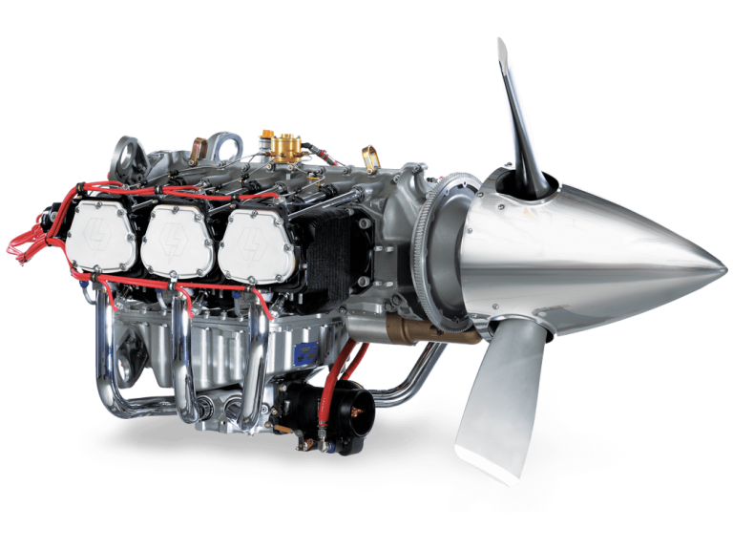
7.6.1 Piston Engine Scaling
For a piston engine:
Engine power is directly proportional to:
Air mass flow
Fuel mass flow
Number of cylinders
Engine cubic capacity (cylinder volume)
Engine weight may be assumed to be proportional to engine power:
Notes:
Source: https://www.lycoming.com/sites/default/files/styles/medium_hq/public/image/2021-11/header-engine_1.png

Slide 8

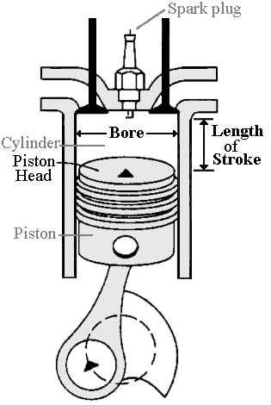
7.6.1 Piston Engine Scaling
How to scale a piston engine:
Start from specified engine power (kW or HP)
Look (online) for comparable engines and their specific data
Ensure that similar thermodynamic conditions exist (similar velocities, cruise conditions…)
Select an engine close to your power requirements
Scale the engine power (as needed):
You may change the number of cylinders
E.g. You may replace a 4 cylinder engine by a 6 cylinder engine. i.c. the shaft power increases by 50%
You may increase the cylinder volume and thus modify mass flow
Scale the engine stroke (directly proportional) and/or piston diameter (proportional to square root of mas flow)
If this requires significant changes in piston speed, piston bore or stroke, the number of cylinders should be modified
Scale the engine weight according to the following equation:
For assignment 2, assume a = 1

Slide 9
Lecture Contents
Preliminary Propulsion Sizing
7.1. Introduction
7.2. Gas Generators
7.3. Gas Turbine Thermodynamics (Recap)
7.3.1 Ideal Cycle
7.3.2 Gas Power & Efficiency
7.3.3 Real Processes
7.4. Gas Turbine Classifications & Configurations
7.5. Governing Equations of Gas Turbines
7.6. Engine Scaling techniques
7.6.1 Piston Engine Scaling
7.6.2 Propeller Engine Scaling
7.6.3 Turbojet Engine Scaling
7.6.4 Effects of Altitude and Velocity
7.7. Engine Manufacturers & Joint Programs
7.8. Future Developments
Notes:
Contents from this slide deck is sourced and adapted from Aircraft Design 1 Course. Content by Dr. Arvind. G. Rao and prof J.P. van Buijtenen from Delft, University of Technology

Slide 10
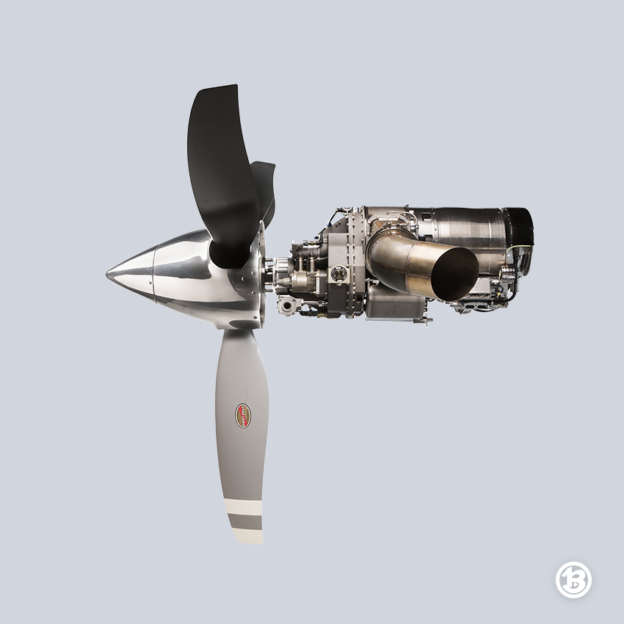
7.6.2 Propeller Engine Scaling
For a propeller engine, it can be shown that (when neglecting compressibility):
Using dimensional analysis, the following coefficients are obtained:
or:
With:
n = Propeller rotations/sec
D = Propeller diameter
C₀ = flight speed
T = thrust
Thrust Coefficient
Torque Coefficient
Power Coefficient

Slide 11
7.6.2 Propeller Engine Scaling
Thrust, Power and Efficiency:
Propeller Efficiency:
Propeller tip speed:
Advance Ratio J:
C₀
V_{tip}
With:
Advance ratio = true airspeed / tipspeed
n = Propeller rotations/sec
D = diameter

Slide 12
7.6.2 Propeller Engine Scaling
The propulsive efficiency can be rewritten as:
Then, the thrust can be rewritten as:
Rearranging

Slide 13
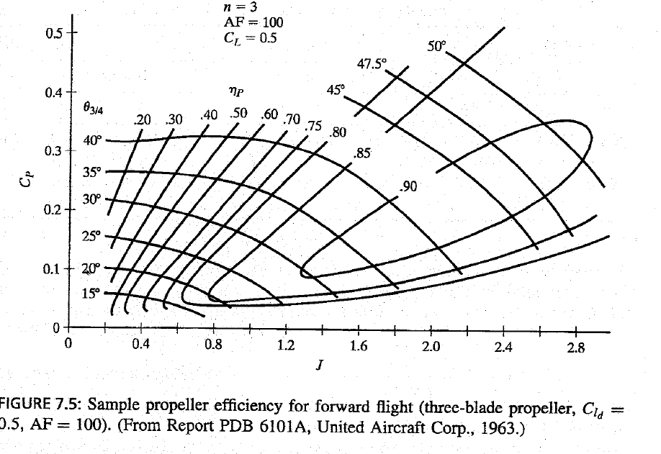
7.6.2 Propeller Engine Scaling
Propeller Efficiency:
Notes:
Can be identified from historical data as a function of cP and J

Slide 14
7.6.2 Propeller Engine Scaling
Example, consider an aircraft with the following requirements:
Cruise speed C₀ = 120 m/s
Propeller efficiency: η_{P} = 80 % (assume start value)
Take thrust level per engine at cruise was determined from assignment 2 to be T_{TO} = 5 kN
Cruise altitude resulted in a calculated velocity of sound a = 320 m/s and accompanying air density ρ = 0.7 kg/m3
Maximum M_{tip} ≤ 0,85 to avoid supersonic tip speeds
We can now calculate the thrust as follows:
Calculate P_{required}:
Calculate max tip speed:
Use references to identify a typical engine RPM for this engine power (750kW), in this case, 2000RPM
Calculate Preq

Slide 15
7.6.2 Propeller Engine Scaling
We can now calculate the thrust as follows:
Calculate P_{required}:
Calculate max tip speed:
Use references to identify a typical engine RPM for this engine power (750kW), in this case, 2000RPM
Now calculate the propeller diameter:
Calculate the advance ratio:
Calculate the Cp:
Calculate Preq
Rearrange

Slide 16
7.6.2 Propeller Engine Scaling
7. Find the Propeller Efficiency:

Slide 17
7.6.2 Propeller Engine Scaling
8. Now calculate C_{F}:
9. Finally, calculate T (the thrust) from C_{F} :
Compare the Calculated thrust (i.c. 5.9kN) with the required thrust (5kN)
If deviation is large (>50%), adjust initial values and iterate
If deviation is <50%, one can trust main values, as real performance requires much more design details of the propellers. The values obtained are within preliminary design boundaries
Rearrange

Slide 18
Lecture Contents
Preliminary Propulsion Sizing
7.1. Introduction
7.2. Gas Generators
7.3. Gas Turbine Thermodynamics (Recap)
7.3.1 Ideal Cycle
7.3.2 Gas Power & Efficiency
7.3.3 Real Processes
7.4. Gas Turbine Classifications & Configurations
7.5. Governing Equations of Gas Turbines
7.6. Engine Scaling techniques
7.6.1 Piston Engine Scaling
7.6.2 Propeller Engine Scaling
7.6.3 Turbojet Engine Scaling
7.6.4 Effects of Altitude and Velocity
7.7. Engine Manufacturers & Joint Programs
7.8. Future Developments
Notes:
Contents from this slide deck is sourced and adapted from Aircraft Design 1 Course. Content by Dr. Arvind. G. Rao and prof J.P. van Buijtenen from Delft, University of Technology

Slide 19
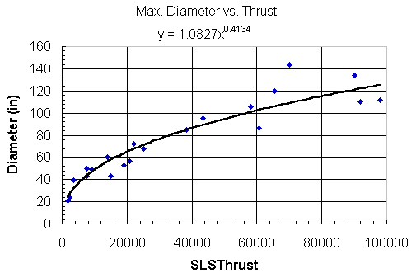
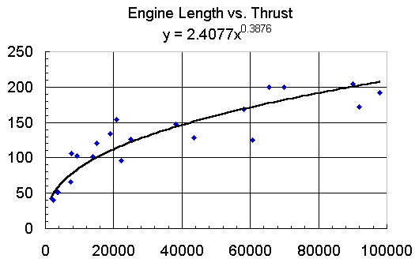

7.6.3 Engine Scaling (Wing-Mounted Engines)
Engine size and thrust are related. The engine can be Rubberized for fast size estimations:
Notes:
Biggest design challenge = fitting all the equipment in the slender pylon. Fuel lines, pneumatic lines, engine and reverser controls, electrical cables, and numerous instrumentation leads must fit closely and yet permit maintenance access.
The nacelle is made as small as possible but must provide space for all accessories plus ventilation for accessory and engine cooling. The nacelle diameter tends to be roughly 10% greater than the bare engine to accommodate various engine systems. The inlet itself extends about 60% of the diameter in front of the fan face, and the actual inlet area is about 70% of the maximum area, although this varies depending on the engine type. For initial sizing, a representative engine may be selected and scaled (within reason) to the selected thrust level.
One would expect the engine dimensions to vary with the square root of the thrust ratio (so that the area and mass flow are proportional to thrust). Statistically, the scaling is a bit less than the square root. The plots below show the variation in nacelle diameter and length as the thrust varies. Note that the plots in the slide show engine diameter and length, rather than nacelle dimensions. The nacelle must be scaled up as described above. (Source Stanford.edu)

Slide 20
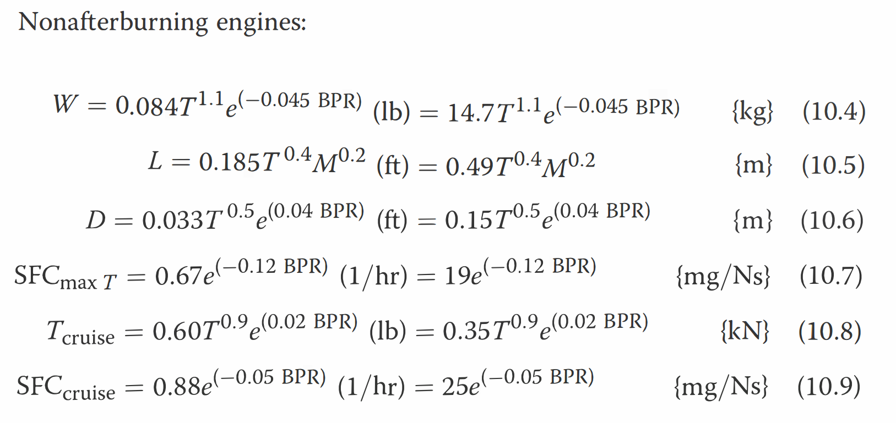
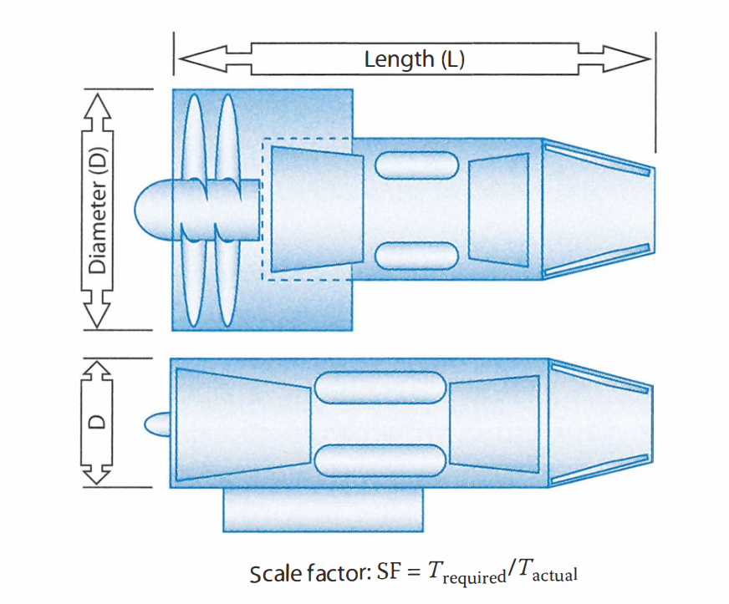
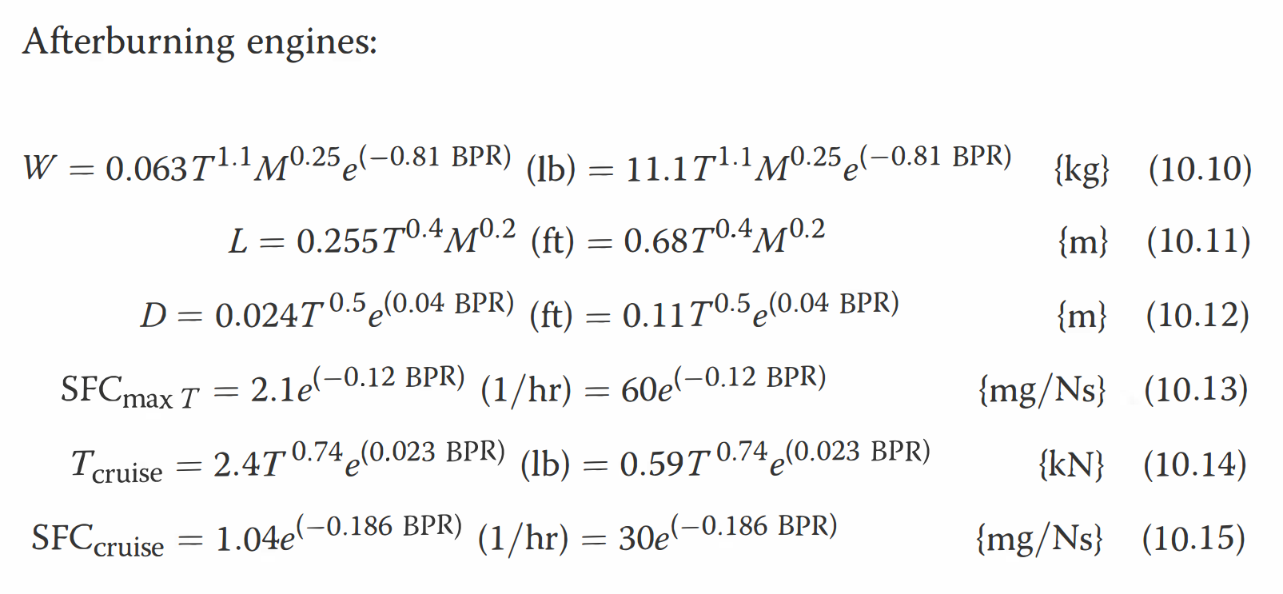
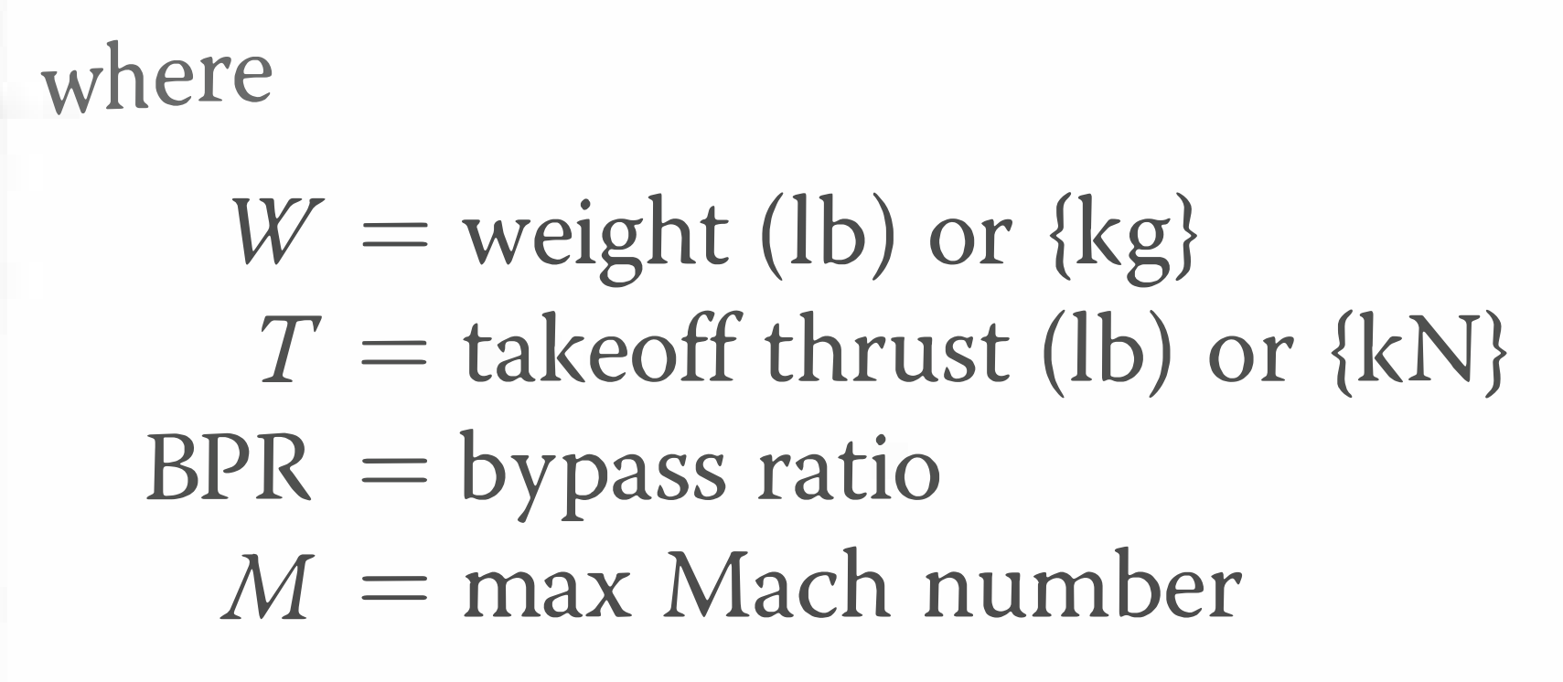
7.6.3 Engine Scaling
Engine Scaling Equations:
Notes:
Source: Raymer

Slide 21
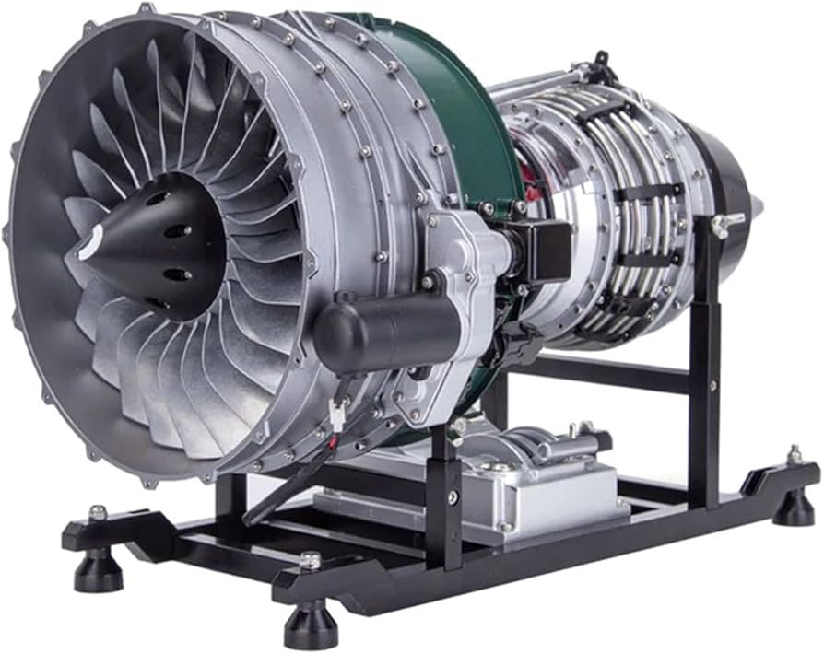
7.6.3 Turbo-jet Engine Scaling
How to scale a jet engine:
Start from specified engine thrust (kW or kJ)
Look (online) for comparable engines and their specific data*
Select an engine close to your thrust requirements
Scale the engine thrust (see next slides)
Scale the engine weight and size (see next slides)
Notes:
Ensure that similar thermodynamic conditions exist (similar velocities, cruise conditions…)!

Slide 22
7.6.3 Turbo-jet Engine Scaling
Consider the thrust equation:
The exit point j can be defined as the point where c_{j} = c₀
When considering static thrust or gross thrust: c₀ = 0
Jet velocity c_{j} is not a function of thrust, so thrust may between 2 conditions may be compared as:
With m = mass flow rate per time [kg/s]
c = velocity [m/s]
P = atm. pressures in Pascal [Pa = N/m2]
Ae = nozzle effective area [m2]
T = thrust [N]
J = nozzle exit condition
0 = atmospheric condition
P_{j} = P₀

Slide 23
7.6.3 Turbo-jet Engine Scaling
Turbojet cross-sectional area (diameters) scales with mass flow:
Turbojet weight and size scaling is empirical, similar to piston engine scaling:
Weight scaling (0.8 < a < 1.3):
Length scaling (0.8 < a < 1.3):
For assignment 2, assume a = 1

Slide 24
Lecture Contents
Preliminary Propulsion Sizing
7.1. Introduction
7.2. Gas Generators
7.3. Gas Turbine Thermodynamics (Recap)
7.3.1 Ideal Cycle
7.3.2 Gas Power & Efficiency
7.3.3 Real Processes
7.4. Gas Turbine Classifications & Configurations
7.5. Governing Equations of Gas Turbines
7.6. Engine Scaling techniques
7.6.1 Piston Engine Scaling
7.6.2 Propeller Engine Scaling
7.6.3 Turbojet Engine Scaling
7.6.4 Effects of Altitude and Velocity
7.7. Engine Manufacturers & Joint Programs
7.8. Future Developments
Notes:
Contents from this slide deck is sourced and adapted from Aircraft Design 1 Course. Content by Dr. Arvind. G. Rao and prof J.P. van Buijtenen from Delft, University of Technology

Slide 25
7.6.4 Altitude and Velocity Effects
Altitude and velocity must be accounted for to scale a given thrust value from one flight condition to another: Atmospheric conditions at different altitudes are given by the International Standard Atmosphere
Thrust T is proportional to mass flow:
With A and C constant, thrust is proportional to density
Assuming ideal gas law:
Thrust scales with altitude H (w.r.t. sea level SL) as follows:
Consider the thrust equation:
At high velocities c_{a}, the c_{j}-c_{a} term starts to reduce significantly
So an increase in aircraft velocity decreases thrust
However, increased velocity also increases ram effect, which compensates for loss of thrust
With ρ = atm. Density [kg/m3]
P = atm. pressures [Pascal]
t = atm. temperatures [Kelvin]
T = thrust [N]
For assignment 2, scale thrust only with altitude, neglect velocity effects

Slide 26
Lecture Contents
Preliminary Propulsion Sizing
7.1. Introduction
7.2. Gas Generators
7.3. Gas Turbine Thermodynamics (Recap)
7.3.1 Ideal Cycle
7.3.2 Gas Power & Efficiency
7.3.3 Real Processes
7.4. Gas Turbine Classifications & Configurations
7.5. Governing Equations of Gas Turbines
7.6. Engine Scaling techniques
7.6.1 Piston Engine Scaling
7.6.2 Propeller Engine Scaling
7.6.3 Turbojet Engine Scaling
7.6.4 Effects of Altitude and Velocity
7.7. Engine Manufacturers & Joint Programs
7.8. Future Developments
Notes:
Contents from this slide deck is sourced and adapted from Aircraft Design 1 Course. Content by Dr. Arvind. G. Rao and prof J.P. van Buijtenen from Delft, University of Technology

Slide 27



7.7 Engine Manufacturers
The following companies are leading the aerospace engine industry:
Large Companies:
General Electric (GE) Aviation, US
Pratt & Whitney (P&W), US
Rolls-Royce (RR), UK
‘Smaller’ Companies:
Pratt & Whitney Canada, Canada
Landmark Aviation, US (formely Garrett Aviation)
Rolls-Royce Corporation, US (was Allison, is now owned by RR)
Honeywell, US (was AlliedSignal)
MTU Aero Engines, Germany (owned by the private equity firm Kohlberg Kravis Roberts & Co.)
SNECMA, France (was SNECMA Moteurs, is now a subsidiary of the SAFRAN Group)
Turbomeca, France (helicopters, owned by Snecma)
Avio, Italy (owned by The Carlyle group - 70% - and Cinven - 30%)
Japanese Aero Engines Corporation, Japan (consortium of Kawasaki Heavy Industries, Ishikawajima-Harima Heavy Industries, Mitsubishi Heavy Industries)
Volvo Aero, Sweden
PiaggioAero, Italy

Slide 28
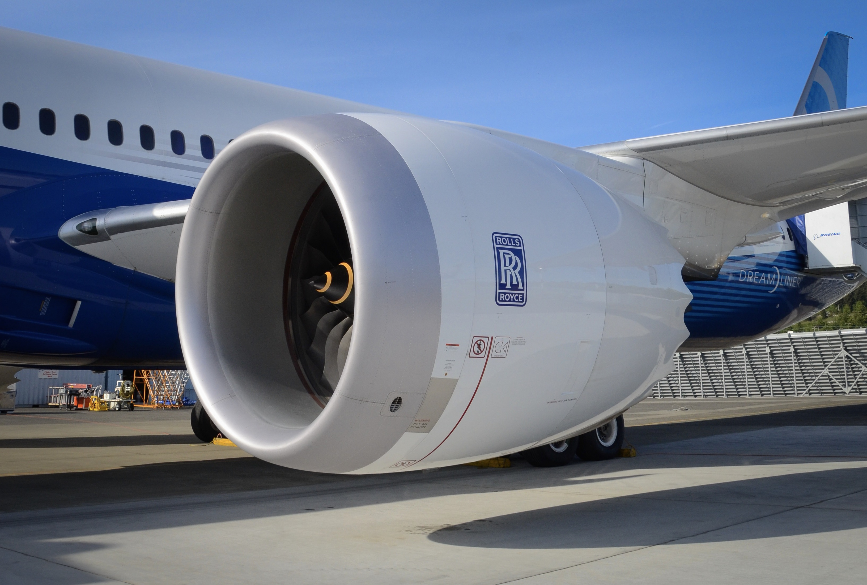
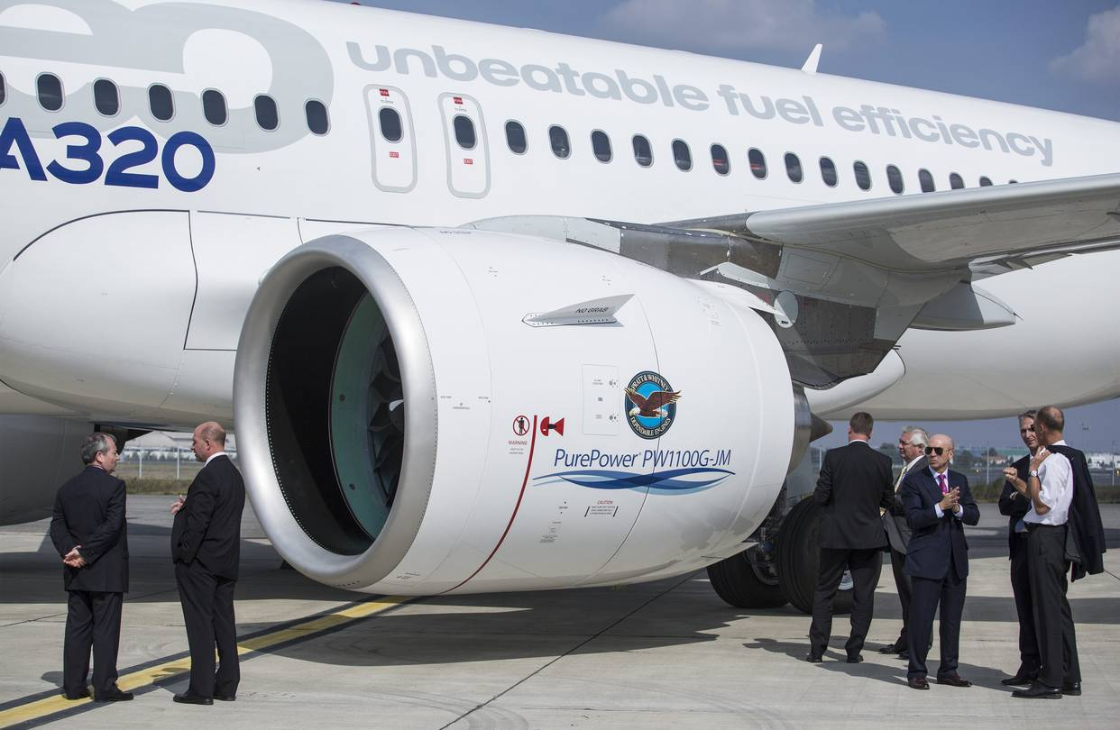
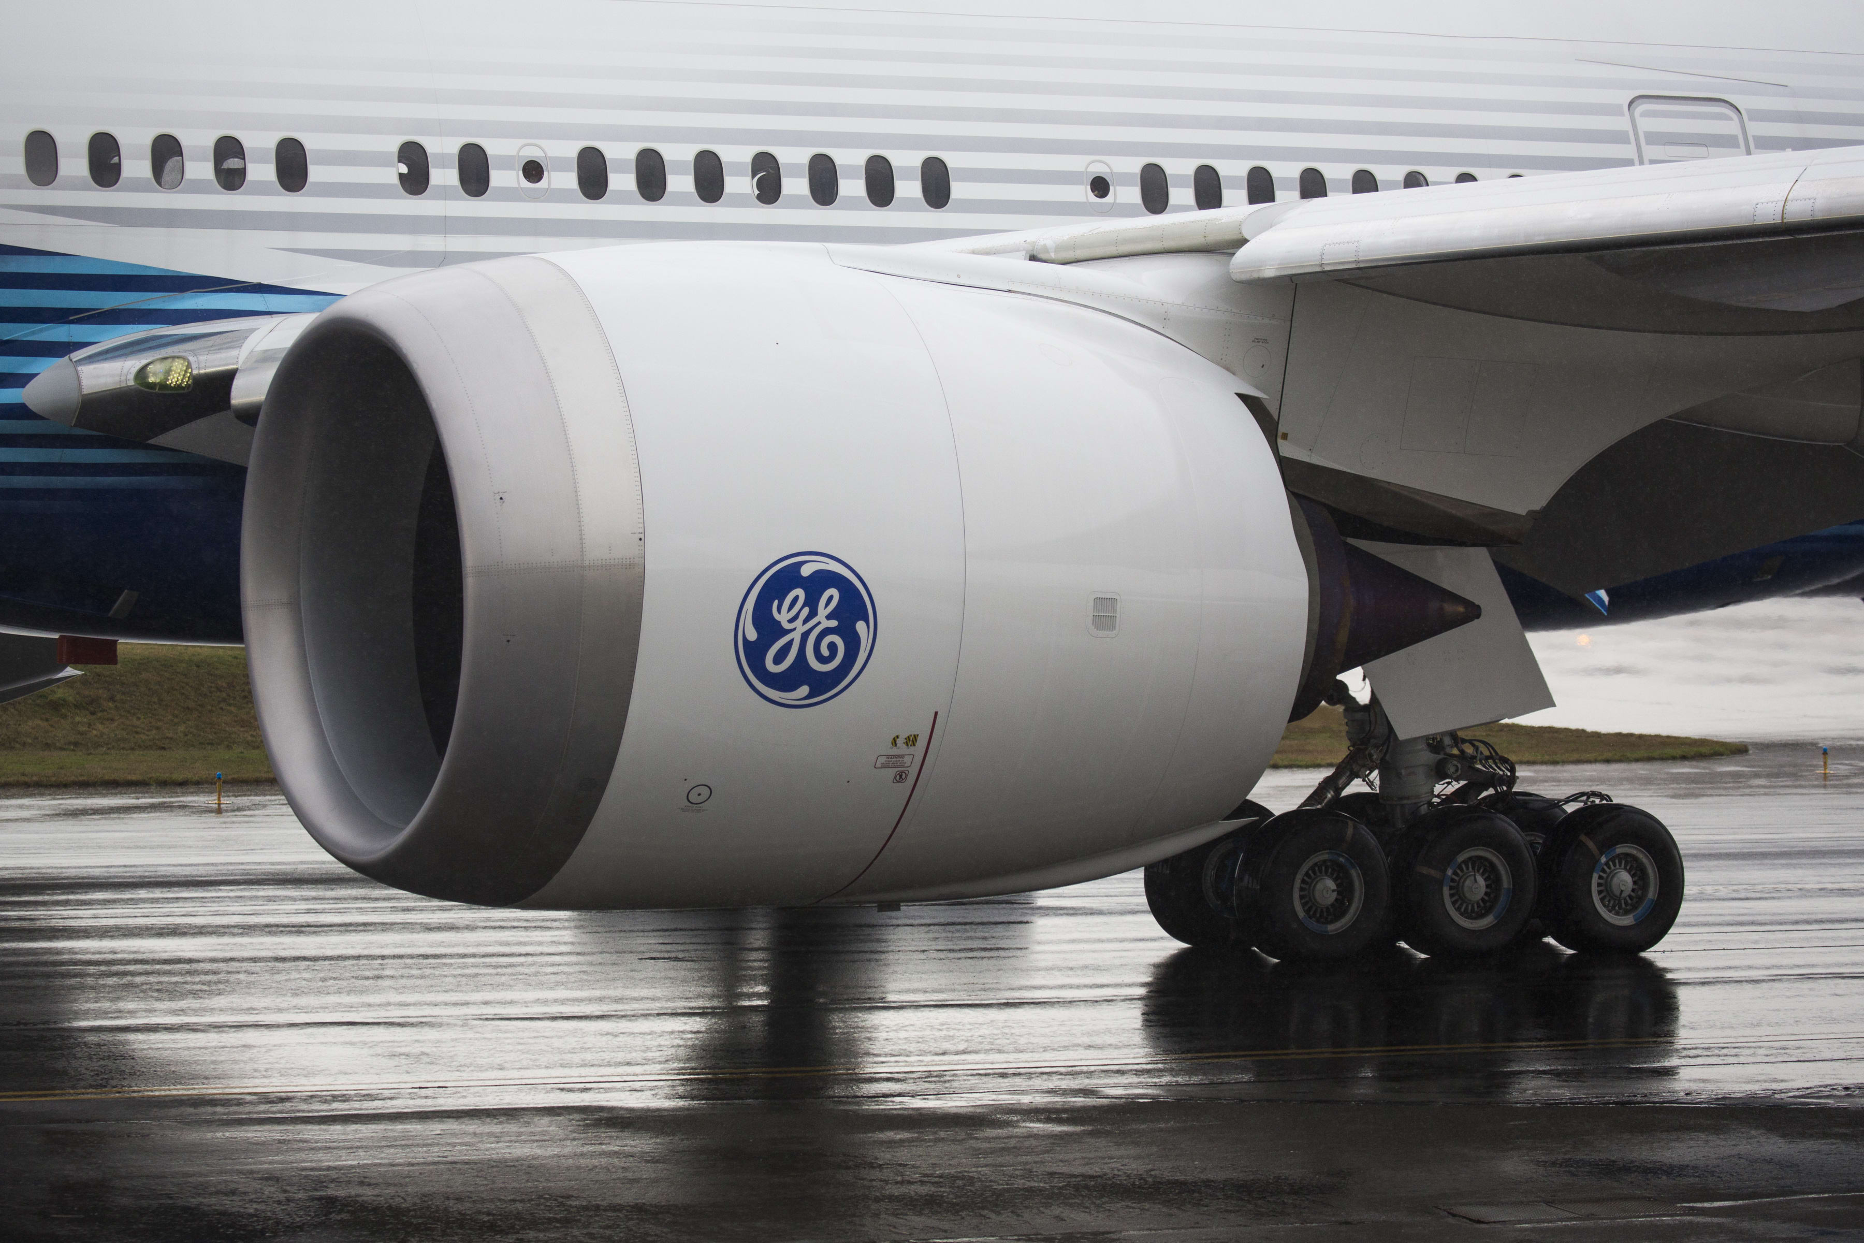
7.7 Engine Manufacturers
The following companies are leading the aerospace engine industry:
Notes:
Sources:
A320 - https://si.wsj.net/public/resources/images/BN-RX176_PRATT0_GR_20170131234901.jpg
B787 - https://theaircurrent.com/wp-content/uploads/2019/01/rolls-royce-trent-1000-787-9-bfi.jpg
B777 - https://image.cnbcfm.com/api/v1/image/106456661-1584970552499gettyimages-1195905882.jpeg?v=1584970617&w=1600&h=900

Slide 29
7.7 Engine Manufacturers
Engines can also be developed from “joint engine development programs”
This is an increasing trend, often involving international efforts
Can be done to share risk and cost of high development costs (often multi-billion $)
Can also later lead to shared revenues for both production and maintenance phases
The following slides show examples of shared development programs:
IAE Superfan V2500 (A319-320-321 family, Boeing MD90)
CFM56 family of engines (B737)
GP7000 engine alliance (A380)
Eurojet EJ200 (Eurofighter Typhoon)

Slide 30
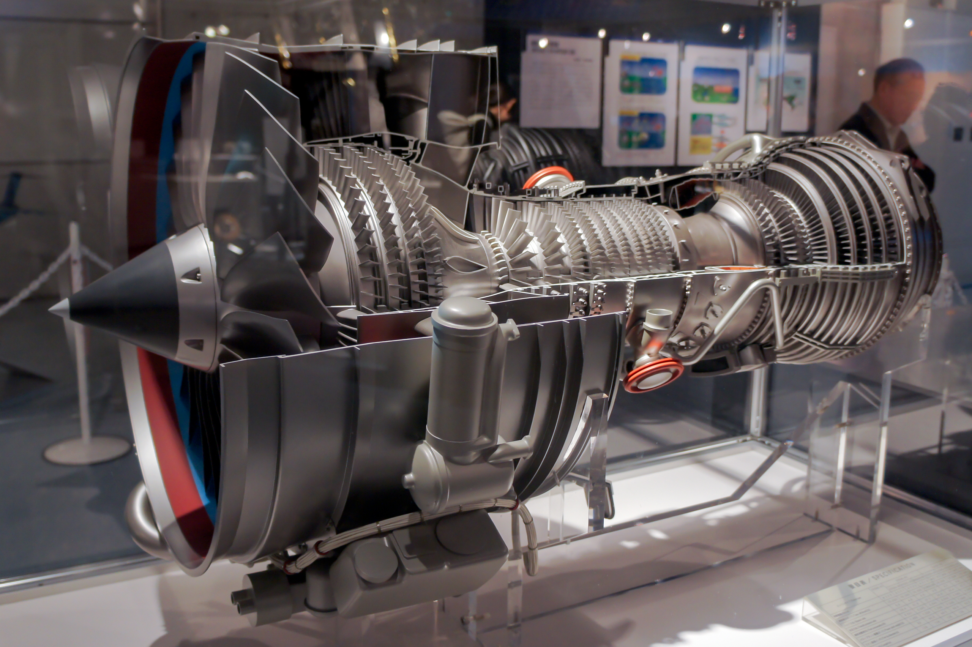
7.7 Engine Manufacturers: Joint Programs 1 – IAE Superfan V2500
Used on A319-320-321 family, Boeing MD90
Work split:
32.5% P&W (diffuser-combustor, HPT and HPT exhaust case)
32.5% Rolls-Royce (HPC gearbox)
23% MTU (LPT module)
12% JAEC (fan case & LPC)
Notes:
Source: www.v2500.com
https://upload.wikimedia.org/wikipedia/commons/f/fd/IAE_V2500_engine_cutaway_model_2010_The_Sky_and_Space.jpg

Slide 31
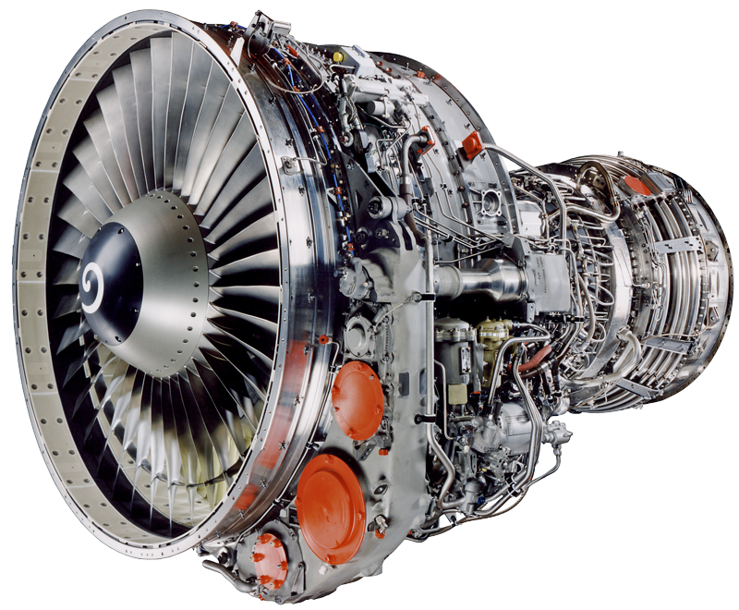
7.7 Engine Manufacturers: Joint Programs 2 – CFM56 family of engines
Used on Boeing 737 family and Airbus A318, A319, A320, A321 and A340 families
Work split:
50% SNECMA (fan, LPT, gearbox & exhaust)
50% GE (Engine core (HPC, combustor and HPT))
Most popular engine ever; over 32645 built (2018)!
Notes:
Development started without a customer in mind! This would never happen nowadays. (Now aircraft manufacturers/airlines request engines to be built)
Source: www.cfm56.com
https://emtc.aero/wp-content/uploads/2019/03/cfm56-3-med.png

Slide 32
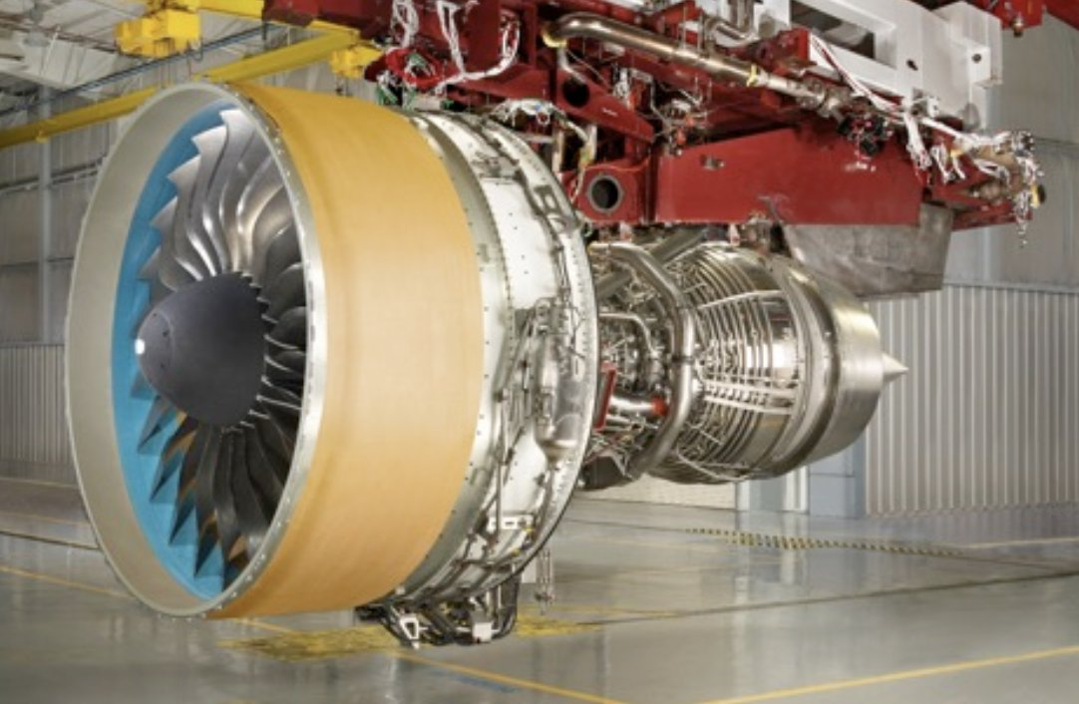
7.7 Engine Manufacturers: Joint Programs 3 – GP7000 Engine Alliance
Used on A380 family
Work split:
50% P&W
40% GE
10% Snecma
Notes:
Source: www.enginealliance.com
https://pbs.twimg.com/media/DTnXvCqVMAEEQUK.jpg

Slide 33
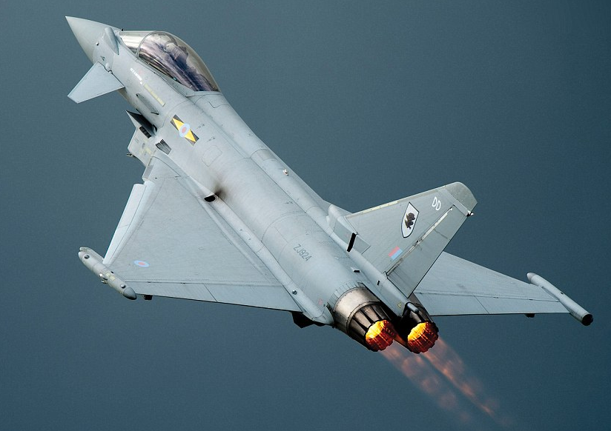
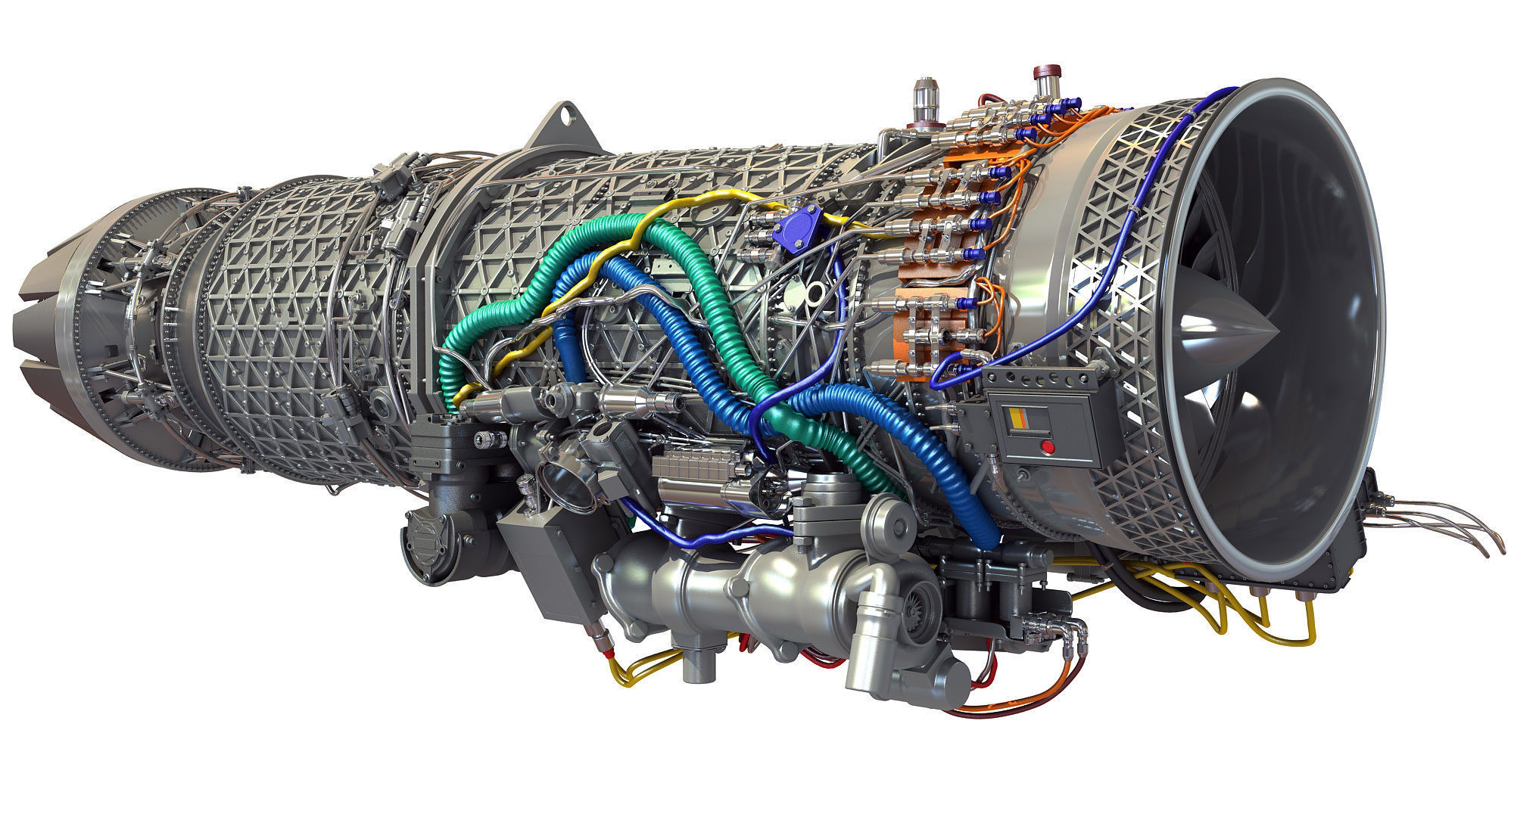
7.7 Engine Manufacturers: Joint Programs 4 – Eurojet EJ200
Used on Eurofighter Typhoon
Work split (development):
33% Rolls Royce (combustion system, HPT, engine health monitoring system)
33% MTU (LPC, HPC, DECMU (digital engine control & monitoring unit))
21% Avio (LPT, reheat/afterburner system)
13% ITP (Spain) (exhaust nozzle, jet pipe, exhaust diffuser, bypass duct, external dressings)
Work split (production):
34.5% Rolls Royce
30% MTU
19.5% Avio
16% ITP (Spain)
Notes:
Source: www.eurojet.de
Images:
https://img2.cgtrader.com/items/762035/502d9ca301/eurojet-ej200-military-turbofan-jet-engine-3d-model-max-bip-3ds-c4d-lwo-lw-lws-ma-mb-hrc-xsi.jpg
https://www.airlive.net/wp-content/uploads/2017/09/article-2336526-1A2AA0D3000005DC-252_964x673.jpg

Slide 34
Lecture Contents
Preliminary Propulsion Sizing
7.1. Introduction
7.2. Gas Generators
7.3. Gas Turbine Thermodynamics (Recap)
7.3.1 Ideal Cycle
7.3.2 Gas Power & Efficiency
7.3.3 Real Processes
7.4. Gas Turbine Classifications & Configurations
7.5. Governing Equations of Gas Turbines
7.6. Engine Scaling techniques
7.6.1 Piston Engine Scaling
7.6.2 Propeller Engine Scaling
7.6.3 Turbojet Engine Scaling
7.6.4 Effects of Altitude and Velocity
7.7. Engine Manufacturers & Joint Programs
7.8. Future Developments
Notes:
Contents from this slide deck is sourced and adapted from Aircraft Design 1 Course. Content by Dr. Arvind. G. Rao and prof J.P. van Buijtenen from Delft, University of Technology

Slide 35
7.8 Future Developments
Future developments of aircraft engines must:
Reduce emissions & noise to meet regulatory requirements
Increase reliability & efficiency to meet operational requirements
Some example options for improvement:
Geared turbofan engines
Open rotor engines
Intercooled and recuperated engines
Different energy sources (electric/fuel cell/hydrogen…)

Slide 36
7.8 Future Developments
Historic trends:
Trent 1000 (50:1)
Trent 1000 (1500C)
GP 7000 (43:1)
Increases in pressure ratios
Increases in firing temperature

Slide 37
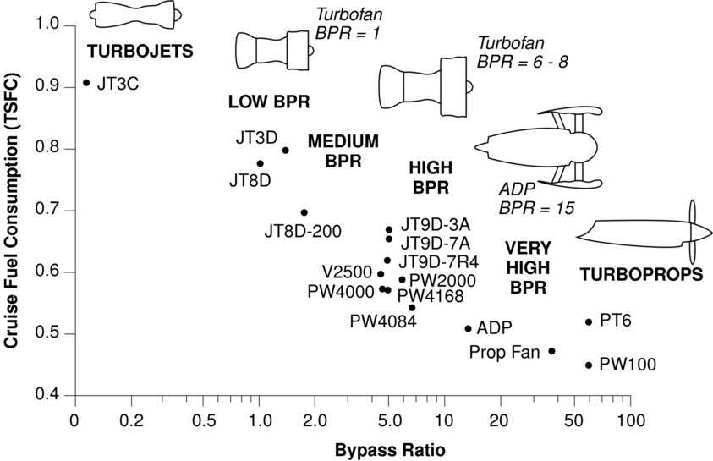
7.8 Future Developments
Historic trends:
Increases in engine efficiency
Efficiency (fuel consumption)/BPR

Slide 38
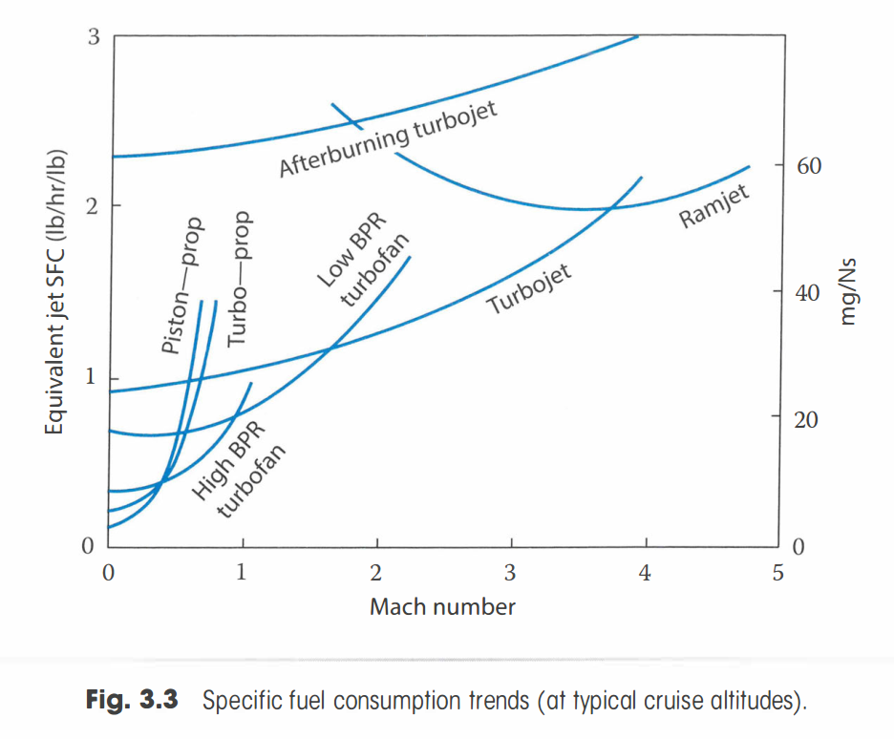
7.8 Future Developments
Other trends:
Fuel Consumption Trends (at cruise)
Efficiency (fuel consumption)/fan pressure ratio

Slide 39
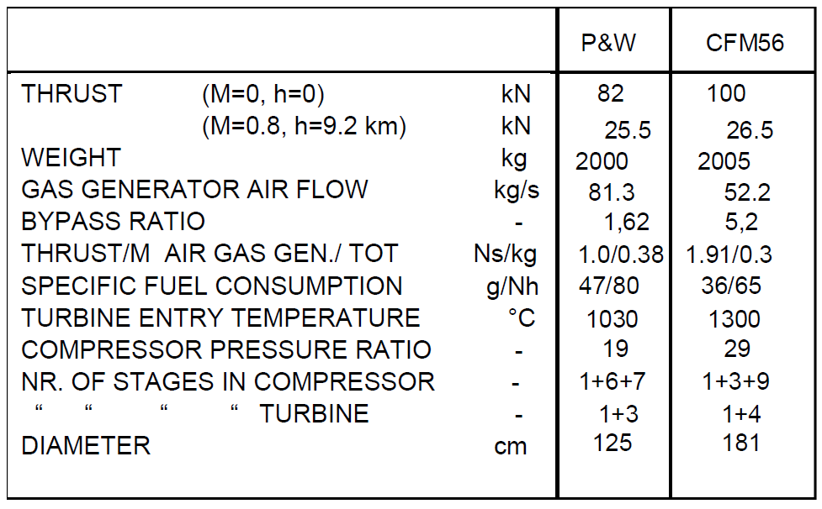
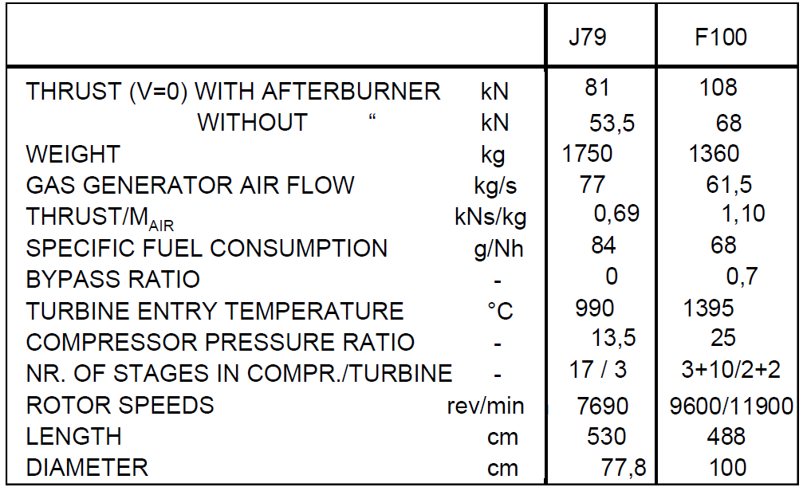
7.8 Future Developments
Example engines:

Slide 40
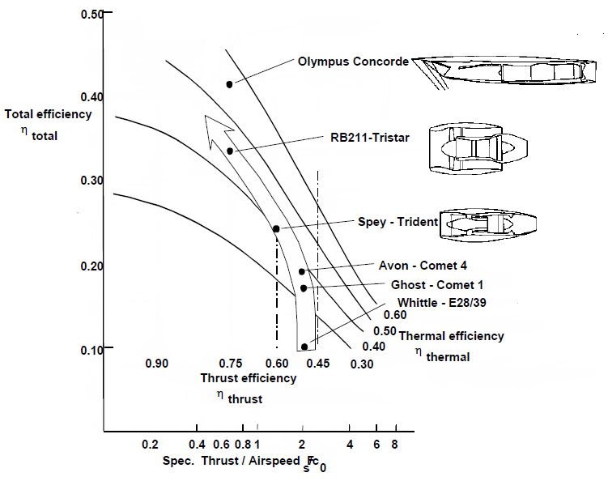
7.8 Future Developments
Other trends:

Slide 41
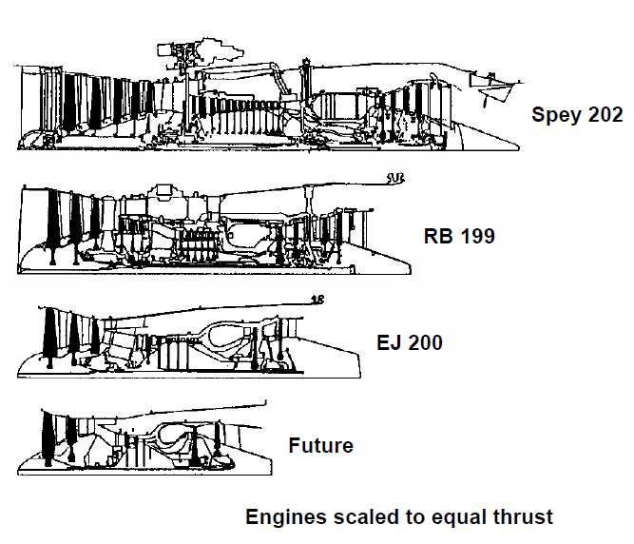
7.8 Future Developments
Other trends: engines are getting smaller (higher power/thrust densities)!

Slide 42
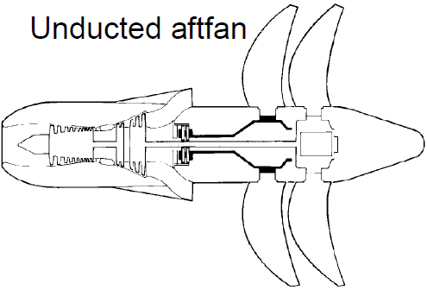
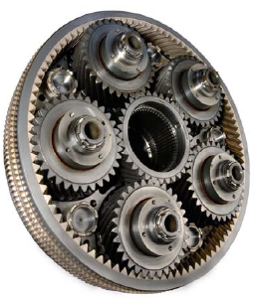
7.8 Future Developments
CFM international
Rolls Royce
Geared Turbofan Engine (P&W1000) Program cost 10B$, operationalized in 2016
Open Rotor Engines

Slide 43
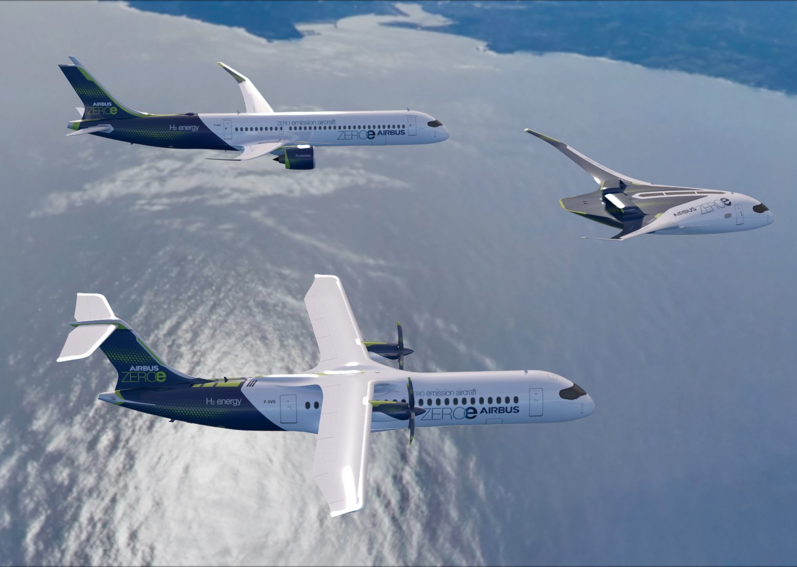
7.8 Future Developments
Intercooled & Recuperated Engine
Airbus hydrogen propulsion concepts (2020!)
Notes:
Source: https://www.airbus.com/newsroom/stories/these-new-Airbus-concept-aircraft-have-one-thing-in-common.html

Slide 44
7.8 Future Developments
Simulation tools (E.g. GSP, gspteam.com) can be used for preliminary sizing and performance estimation of engines

Slide 45
PRELIMINARY PROPULSION SIZING 2
AESP 415 – Aircraft Design Part I Basics
Lecture 10
MODULE
3
TOPIC 7
Thank You!
Dr. Wout De Backer
1000 Catawba St, Ste 120
wdbacker@cec.sc.edu

